Slide 1
Cryptocurrency forecasting using sentiment analysis and machine learning
Introduction to companies and topics in the FINTECH industry

Slide 2

2
Introduction to companies and topics in the FINTECH industry
AGENDA
Idea
AGENDA
Data collection
Sentiment Analysis
Cryptocurrency price prediction

Slide 3
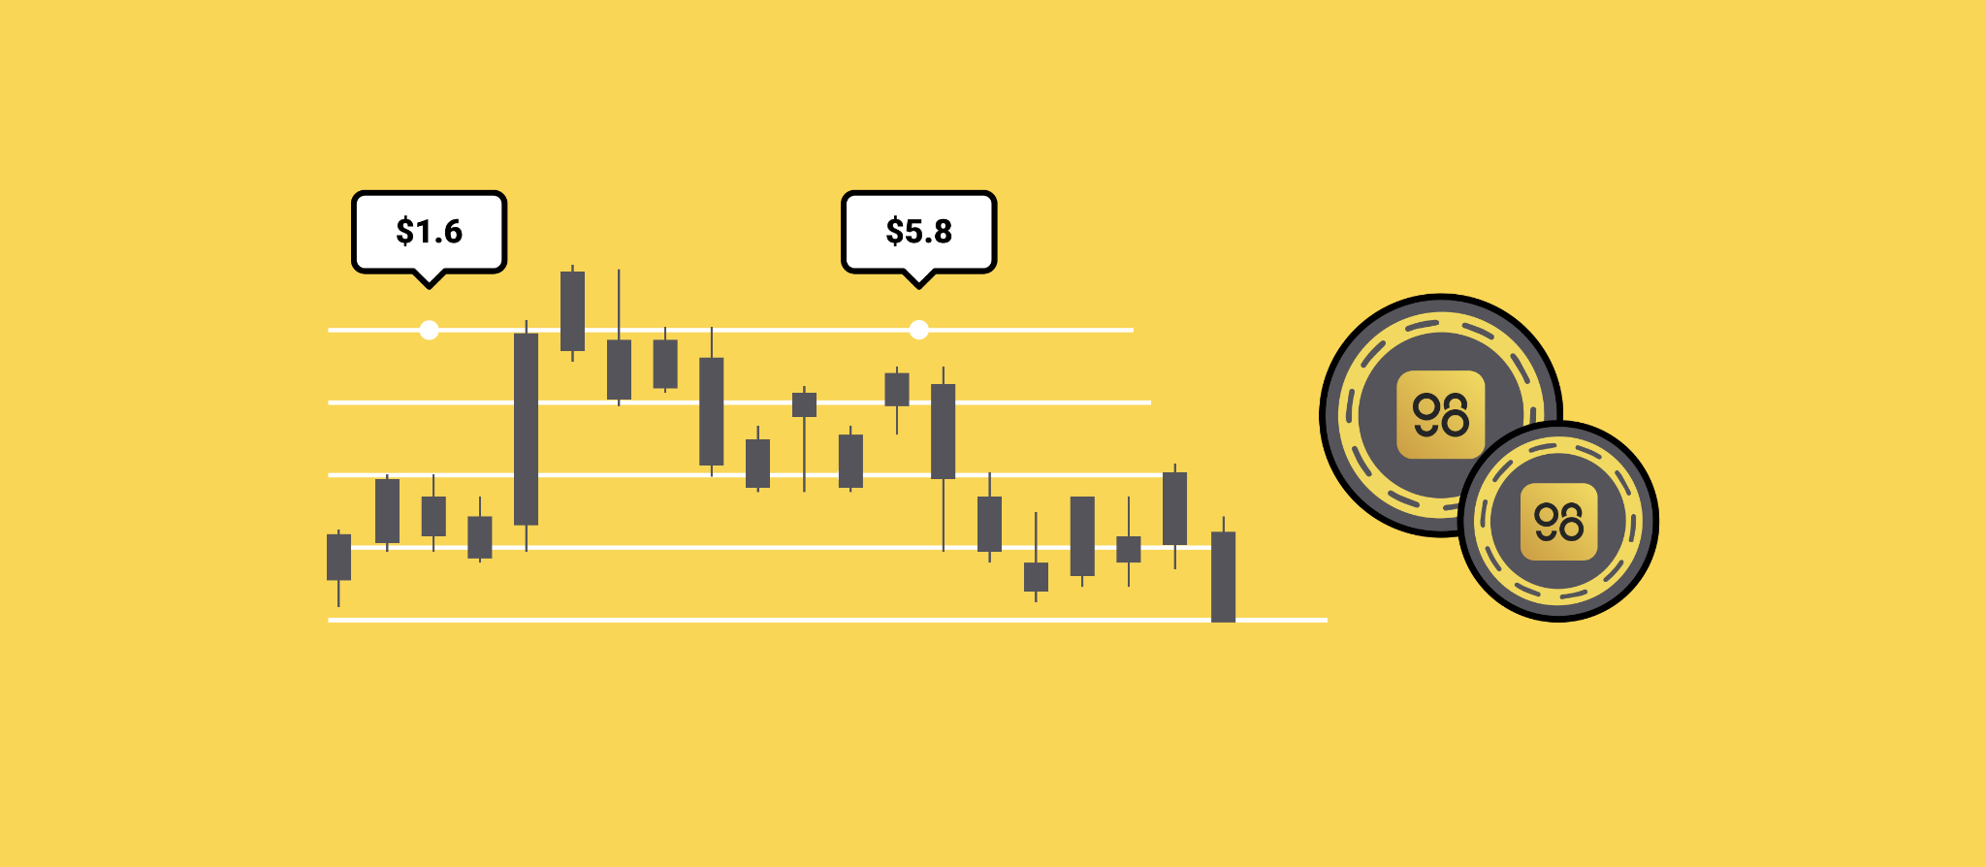
3
Introduction to companies and topics in the FINTECH industry
Idea
The goal of this project is to extract articles about different cryptocurrencies (Royalton Crix Index: Bitcoin BTC, Cardano ANA, Ripple XRP, Ethereum ETH, Binance Coin -) from news sites and to analyze the sentiment of the extracted articles among other factors to forecast the next closing price of cryptocurrencies.
Introduction to companies and topics in the FINTECH industry

Slide 4










4
Introduction to companies and topics in the FINTECH industry
Python Library
Explainer
A Python library is a collection of related modules. It contains bundles of code that can be used repeatedly in different programs
Used Libraries:
Data collection : Scrapy, selenium, cryptocmd, requests, quandl
Data analysis: Pandas, numpy, statsmodel
Visualization: Seaborn, matplotlib, plotly, wordcloud
Sentiment analysis : nltk, Textblob, pysentiment2, transformers, torch
Modelling: Scikitlearn, Pycaret
Introduction to companies and topics in the FINTECH industry

Slide 5
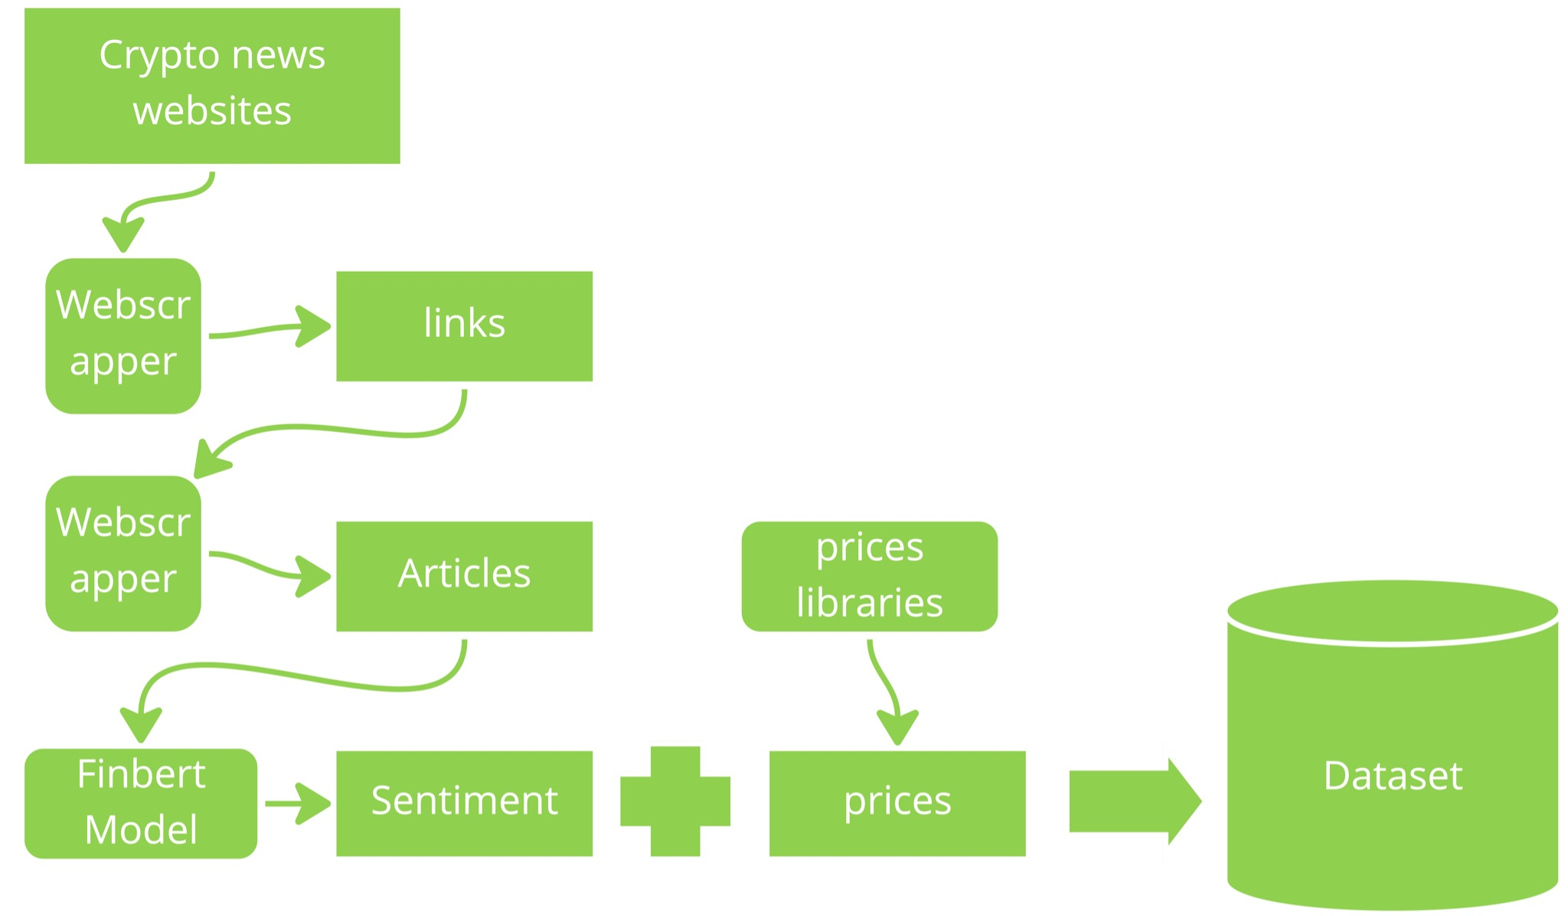
5
Introduction to companies and topics in the FINTECH industry
Data collection - Process
Introduction to companies and topics in the FINTECH industry

Slide 6









6
Introduction to companies and topics in the FINTECH industry
Data collection - Articles
Web scraping: an automatic method to obtain large amounts of data from websites.
Scraped websites: coindesk, coinmarketcap, utoday, cointelegraph
We Scraped multiple websites to have enough daily articles
for the coins.
Data were gathered for the following coins: Binance Coin, Ethereum, Bitcoin, Cardano, XRP
Introduction to companies and topics in the FINTECH industry

Slide 7

7
Introduction to companies and topics in the FINTECH industry
Data collection - Articles
Collecting all the links of the Articles and save them in a csv file
Retrieving the articles using the links retrieved on the first step
Introduction to companies and topics in the FINTECH industry

Slide 8
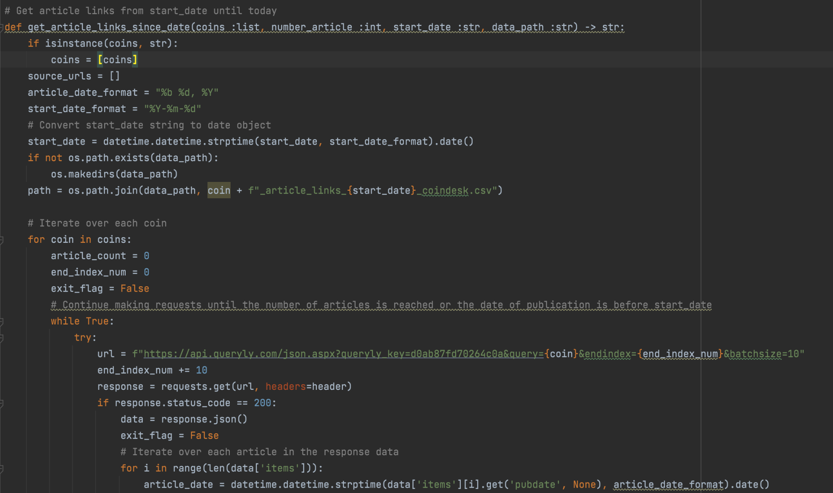
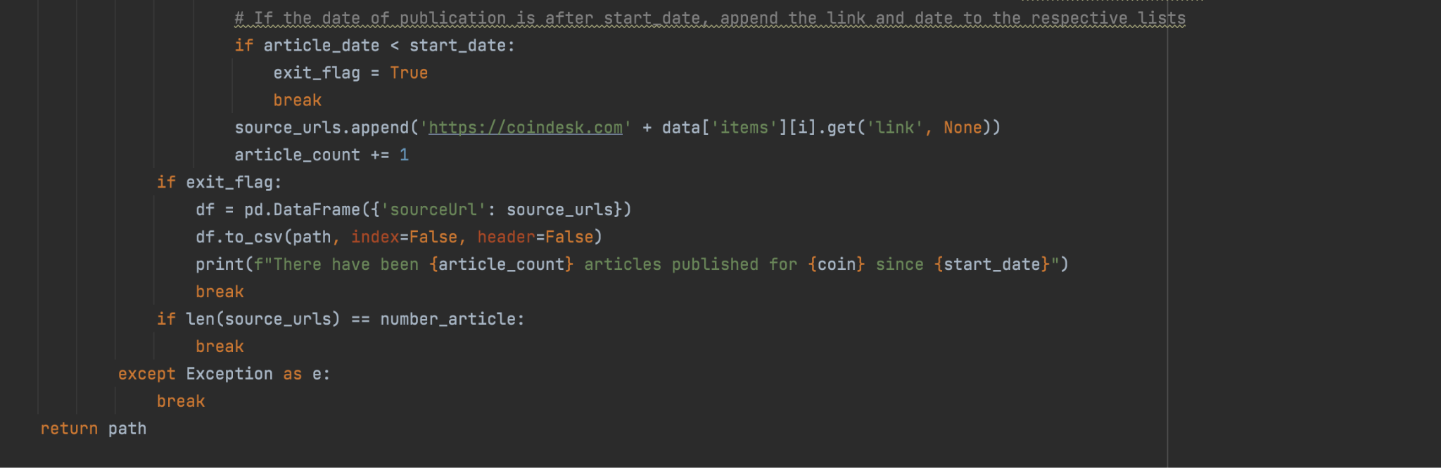
8
Introduction to companies and topics in the FINTECH industry
Data collection - Articles
First step in the Scraping process is to collect all the links of the Articles and and to them in a csv file
Introduction to companies and topics in the FINTECH industry

Slide 9
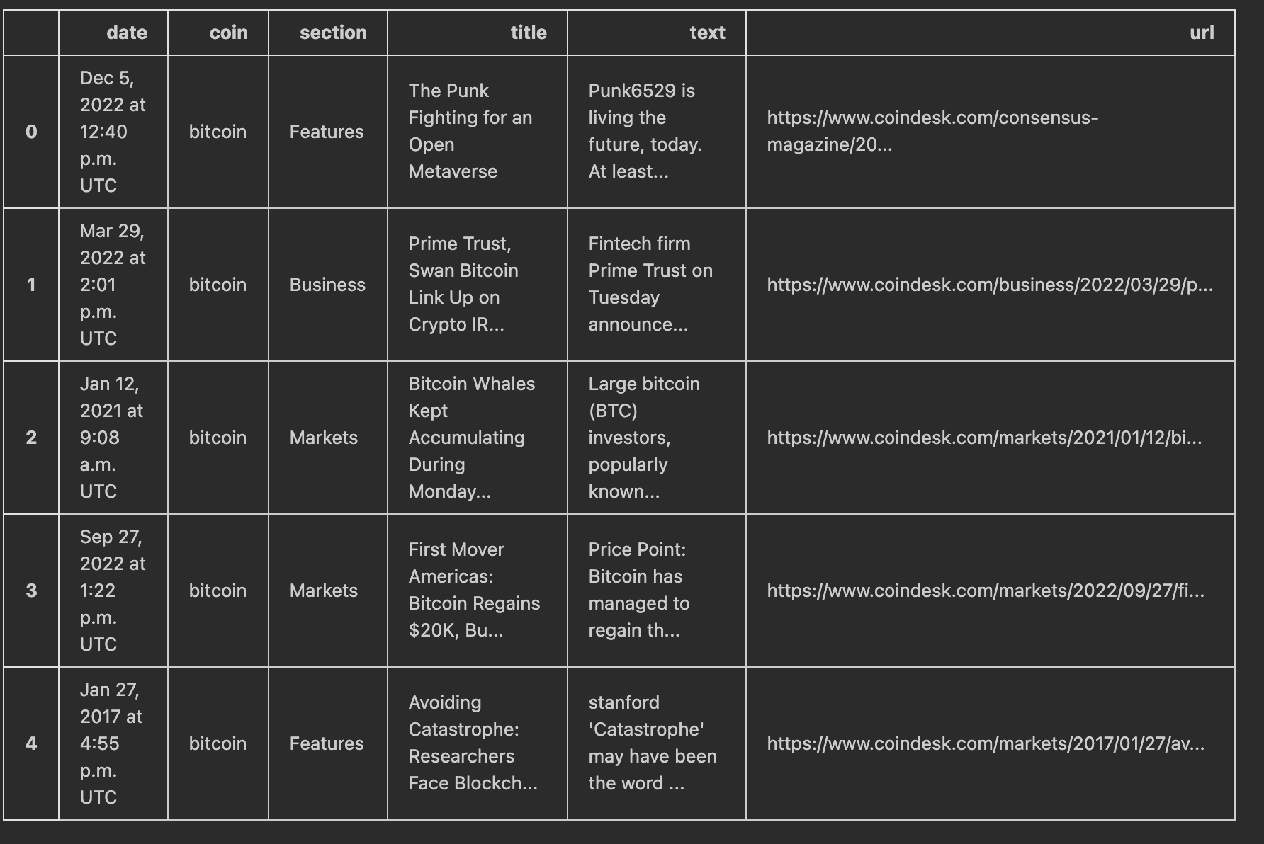
9
Introduction to companies and topics in the FINTECH industry
Data collection - Articles
The retrieved data would include the article, title, text, date, coin, url , section* , all data till 29.12.2022 were collected
* data retrieved from Utody doesn’t have Section column
Introduction to companies and topics in the FINTECH industry

Slide 10
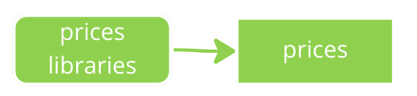
10
Introduction to companies and topics in the FINTECH industry
Data collection - Prices
Third step is to retrieve the historical prices using cryptomd library
cryptomd : Cryptocurrency historical market price data scraper written in Python. (coinmarketcap.com)
collected Data : Date, Open, High, Low, Close, Volume, Market Cap
Date Range: all prices till 29.12.2022
Quandl API nasdaq.com : API used to get addition BTC data
Collected Data: DIFF, AVBLS, HRATE, TOTBC
DIFF: A relative measure of how difficult it is to find a new block
AVBLS: The average block size in MB.
HRATE: The estimated number of tera hashes per second.
TOTBC: The total number of bitcoins that have already been mined; in other words, the current supply of bitcoins on the network.
Introduction to companies and topics in the FINTECH industry

Slide 11
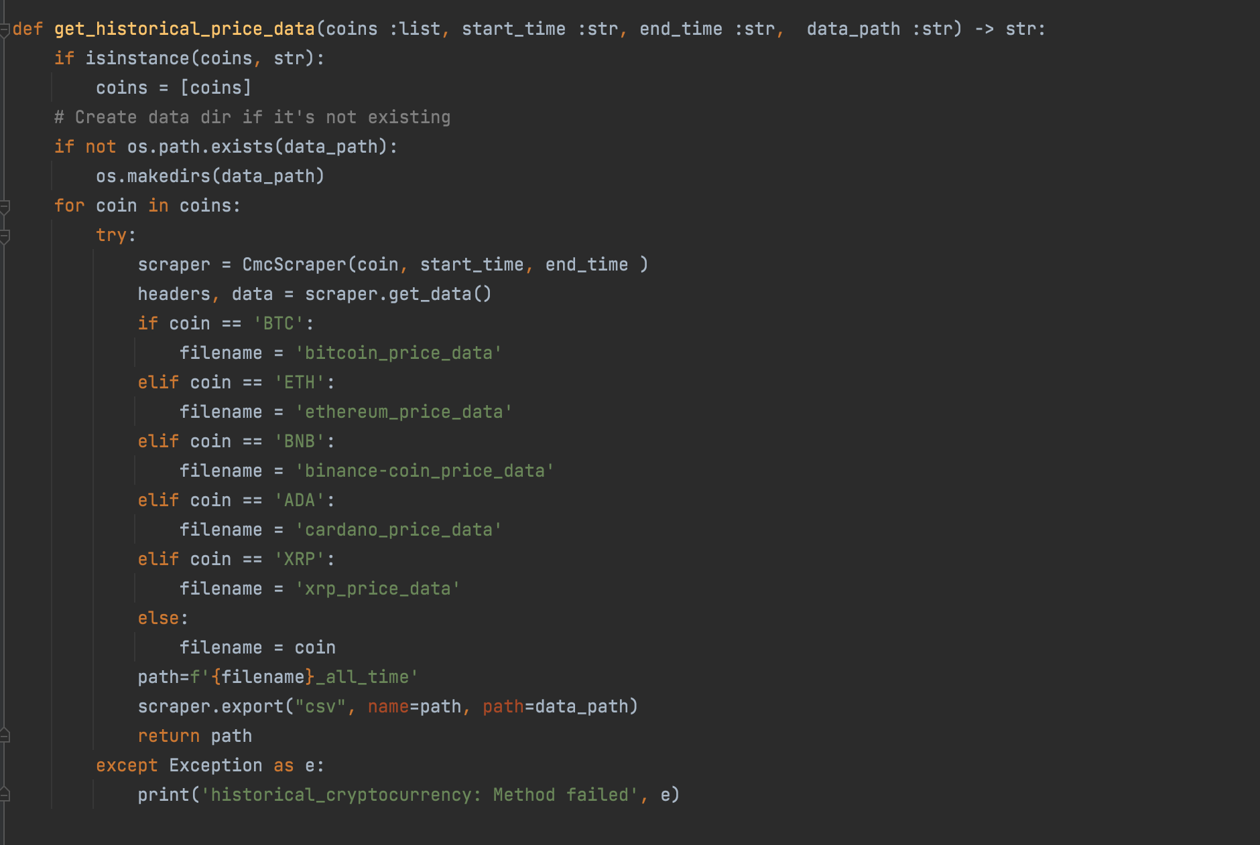
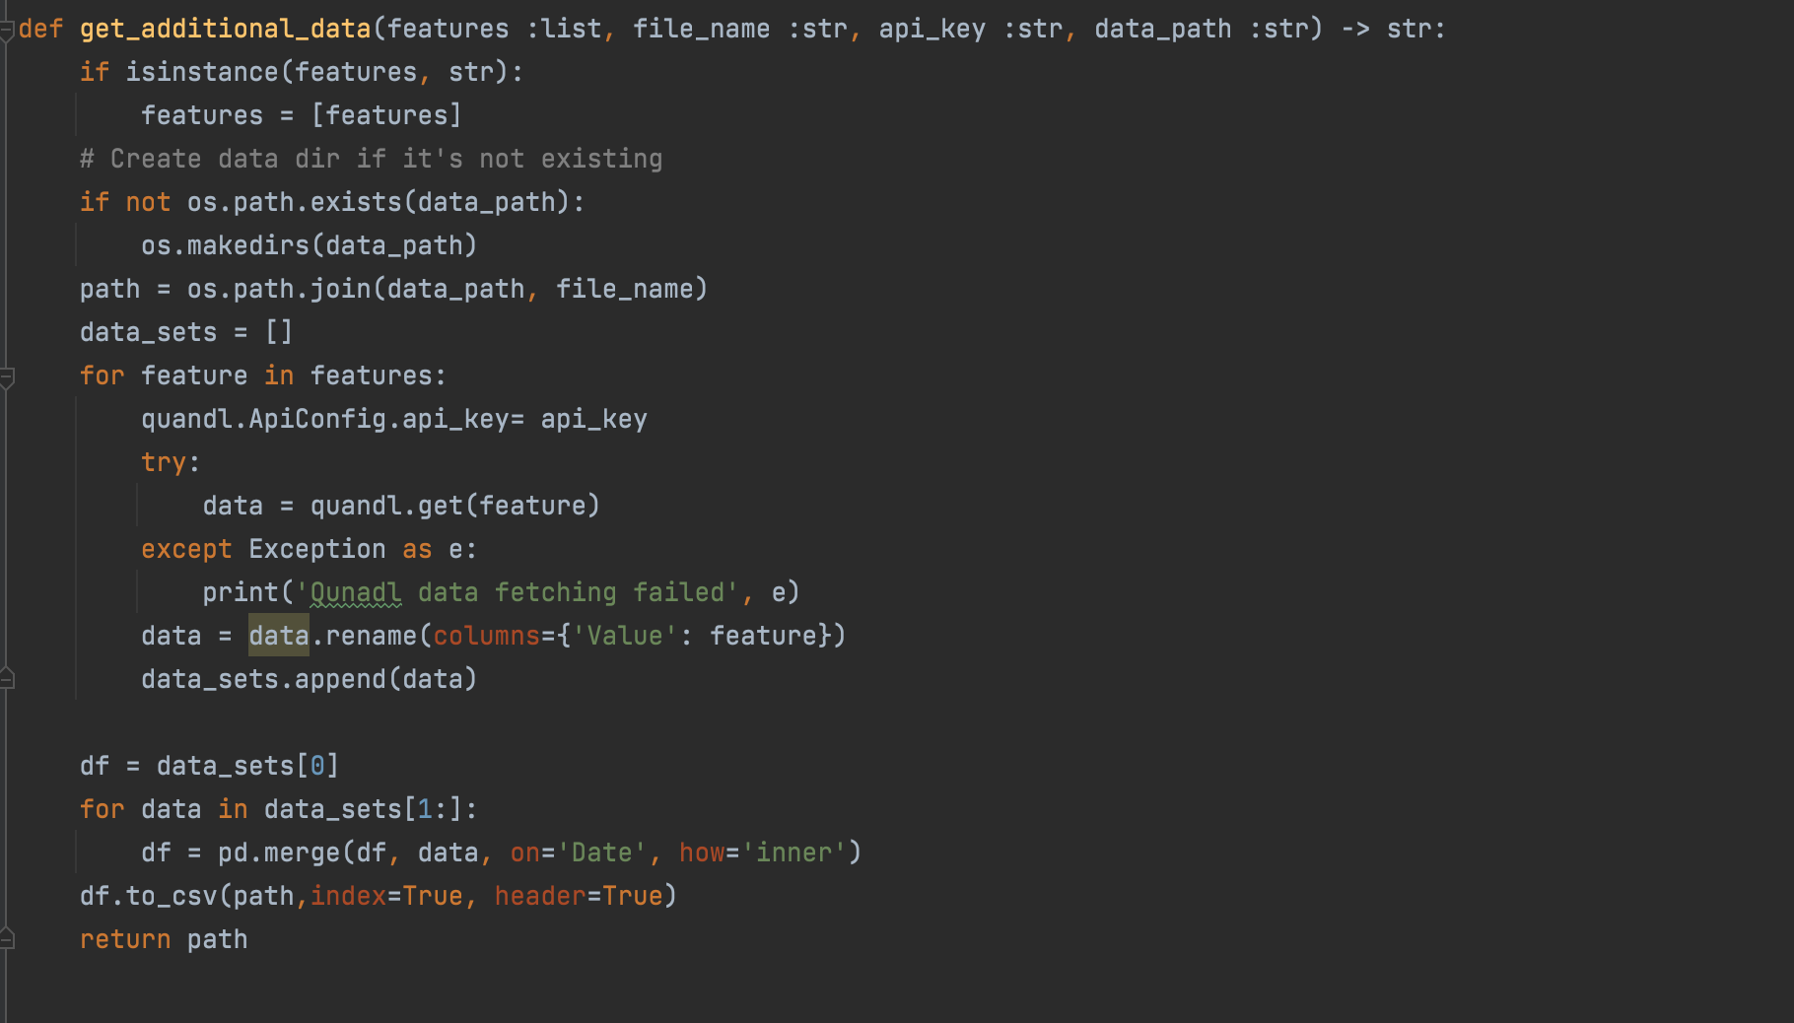
11
Introduction to companies and topics in the FINTECH industry
Data collection - Prices
Code to retrieve historical prices
Introduction to companies and topics in the FINTECH industry

Slide 12
12
Introduction to companies and topics in the FINTECH industry
Sentiment Analysis – Pre-processing
Input
He includes a link to a 01000001 paper <p> titled “Bitcoin: A Peer-to-Peer Electronic Cash System.”'
remove HTML tags
He includes a link to a 01000001 paper titled “Bitcoin: A Peer-to-Peer Electronic Cash System.”
remove ASCII
He includes a link to a paper titled Bitcoin A Peer to Peer Electronic Cash System.
remove hyperlinks
He includes a link to a paper titled Bitcoin A Peer to Peer Electronic Cash System.
remove punctuation
He includes a link to a paper titled Bitcoin A Peer to Peer Electronic Cash System
He includes link to paper titled Bitcoin Peer to Peer Electronic Cash Syste
remove single char
remove whitespace, tokenize, remove stopwords, lemmatize
includes paper titled bitcoin peer peer electronic system
Output
Introduction to companies and topics in the FINTECH industry

Slide 13
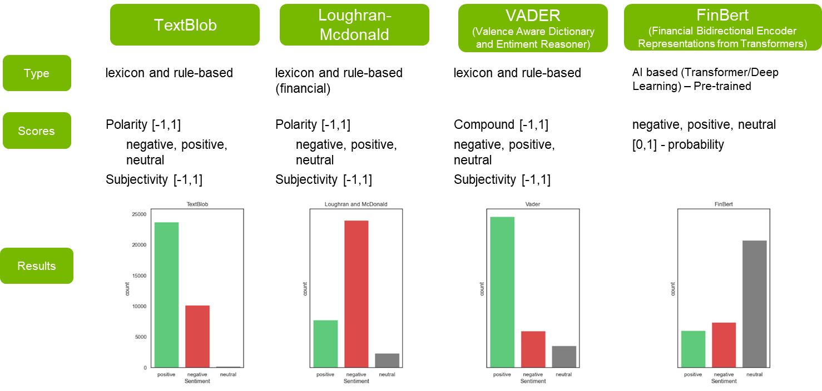
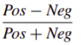
13
Introduction to companies and topics in the FINTECH industry
Sentiment Analysis - Models
Introduction to companies and topics in the FINTECH industry

Slide 14
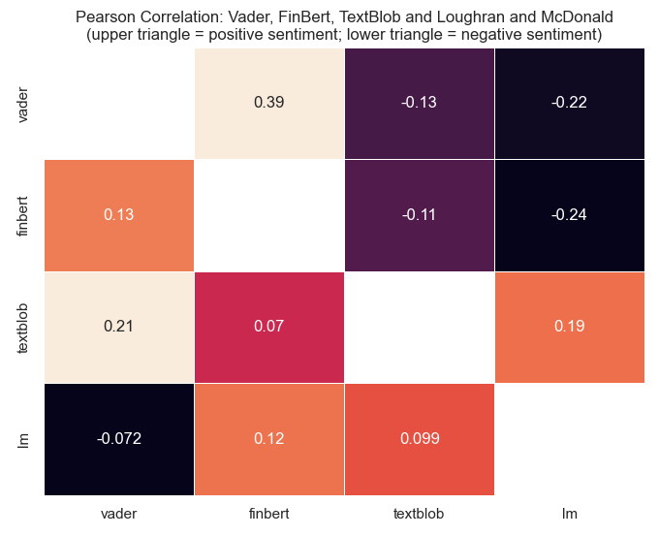
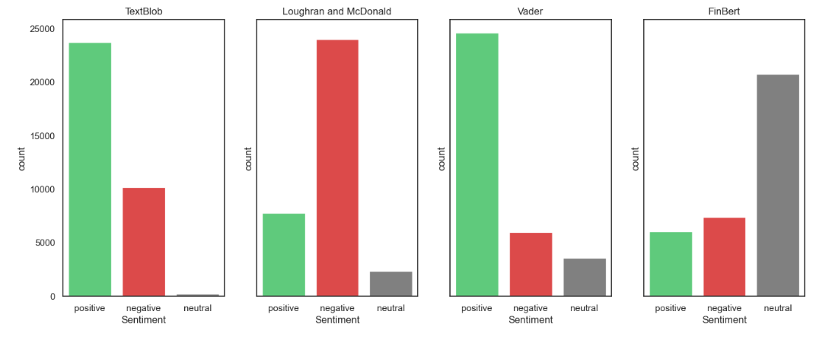
14
Introduction to companies and topics in the FINTECH industry
Sentiment Analysis - Models
Introduction to companies and topics in the FINTECH industry

Slide 15
15
Introduction to companies and topics in the FINTECH industry
Sentiment Analysis - Models
Introduction to companies and topics in the FINTECH industry

Slide 16
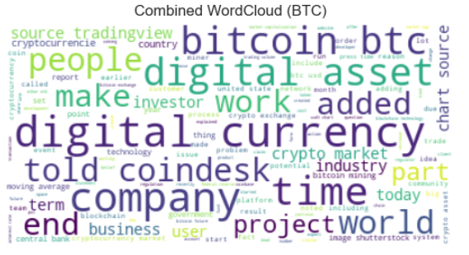
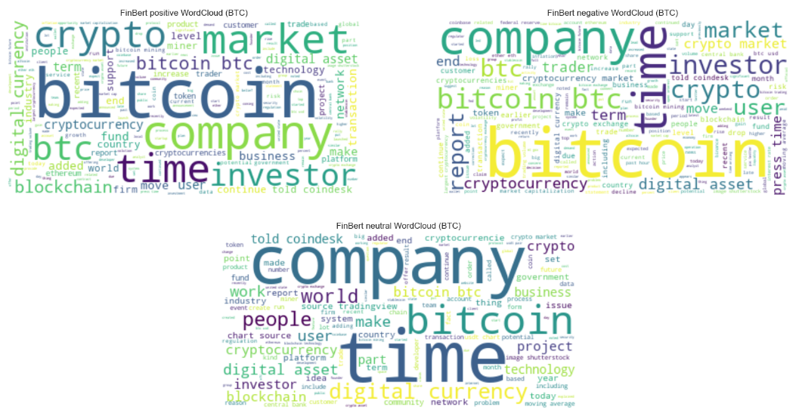
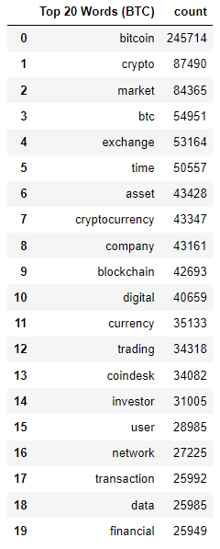
16
Introduction to companies and topics in the FINTECH industry
Sentiment Analysis – Word Clouds
Combined WordCloud
Negative WordCloud
Combined WordCloud Top K Words
Positive WordCloud
Neutral WordCloud
Introduction to companies and topics in the FINTECH industry

Slide 17
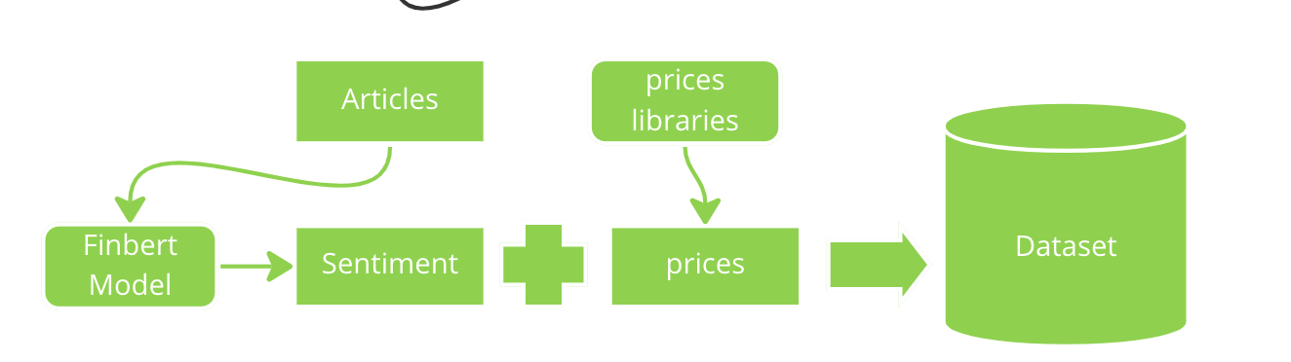
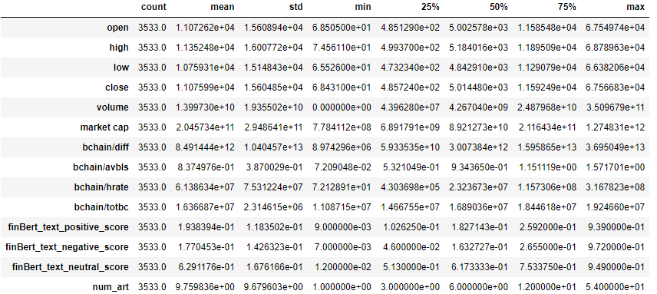
17
Introduction to companies and topics in the FINTECH industry
Cryptocurrency price prediction – Merging Data
Introduction to companies and topics in the FINTECH industry

Slide 18
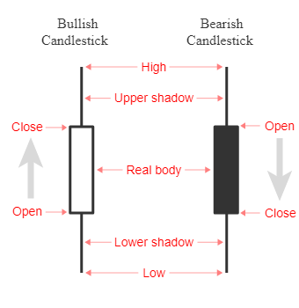
18
Introduction to companies and topics in the FINTECH industry
Cryptocurrency price prediction - Feature Engineering
We used all features from the merged dataset (14):
open, high, low, volume, close, market cap, etc
And also created new features:
upper shadow (close and open – high)
lower shadow (close and open – low)
price_change_absolut (close t – close t₋₁)
rolling mean for 7 and 30 days for open, high, low, close, volume
lag features to remove noise
rolling std for 7 and 30 days days for open, high, low, close, volume
lag features to remove noise
Introduction to companies and topics in the FINTECH industry

Slide 19
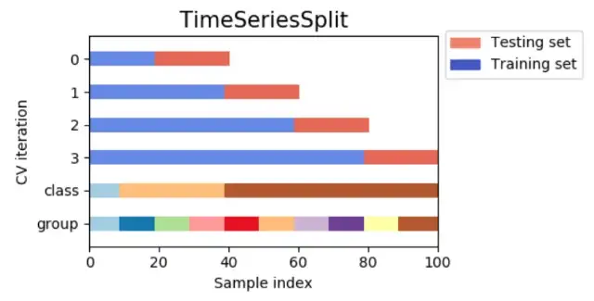
19
Introduction to companies and topics in the FINTECH industry
Cryptocurrency price prediction - Data split & Pre-processing
Dataset was divided into two parts, with 80% of the data used for training and 20% used for testing. This is a common method for evaluating the performance of machine learning models by comparing the results on the unseen test data.
Time Series Split: Instead of randomly dividing the data into k folds, it uses consecutive samples, so that the model can be trained on all data up to a certain point and tested on the data after that point. This allows for the model to simulate a rolling forecast scenario and test how well it would perform on new data in the future.
Normalized the data
Introduction to companies and topics in the FINTECH industry

Slide 20
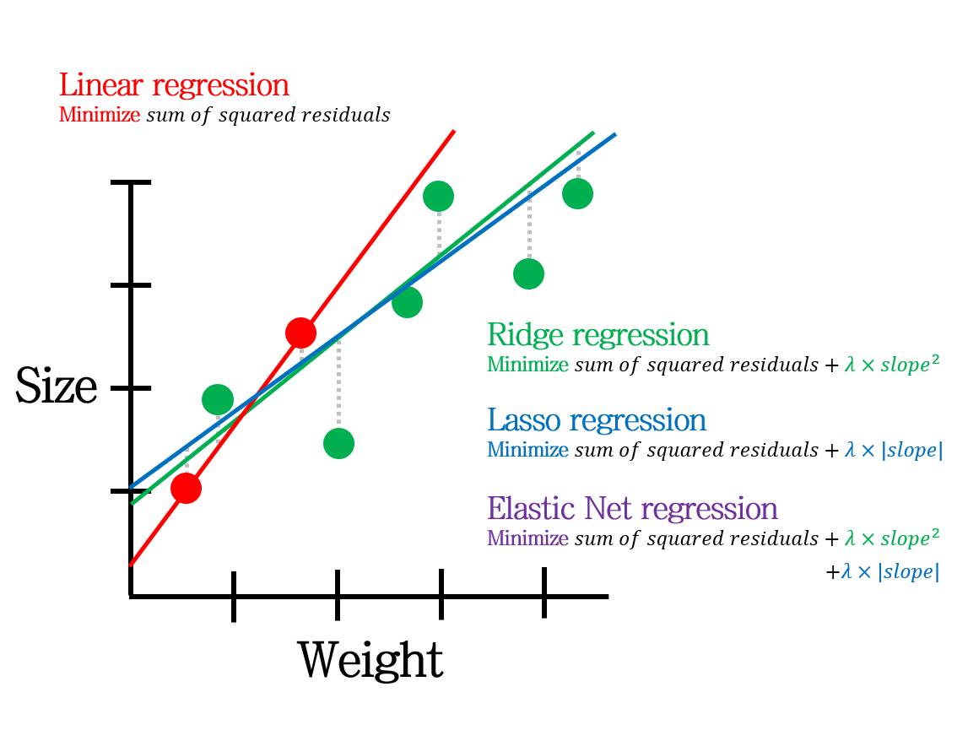
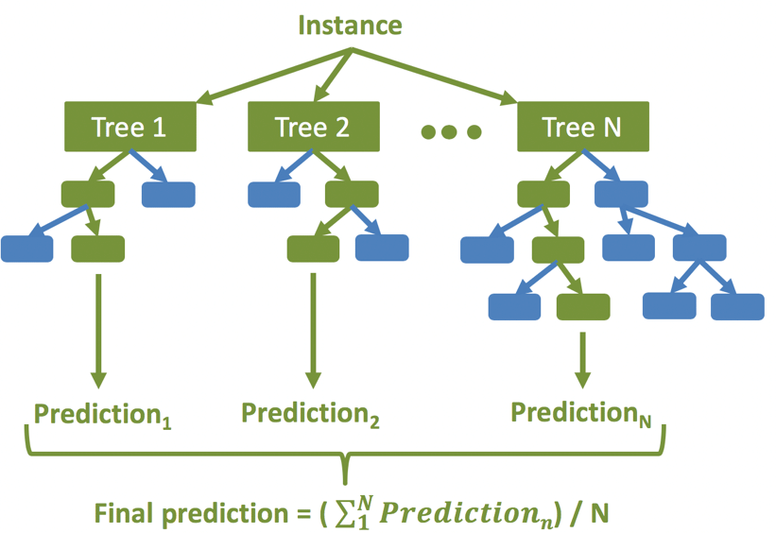
20
Introduction to companies and topics in the FINTECH industry
Cryptocurrency price prediction - Model Selection
Random Forest Regressor
Lasso Regression
Ridge Regression
Many Decision Trees AVG(result)
adds penalty term to the cost function
shrink the coefficients of less important features to zero
adds penalty term to the cost function
shrinking coefficients towards zero
Introduction to companies and topics in the FINTECH industry

Slide 21
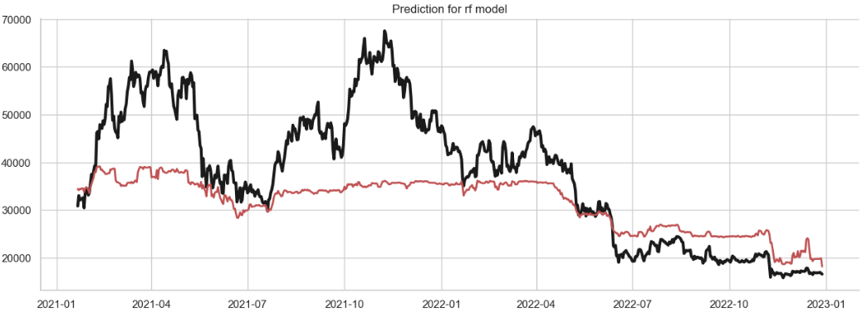
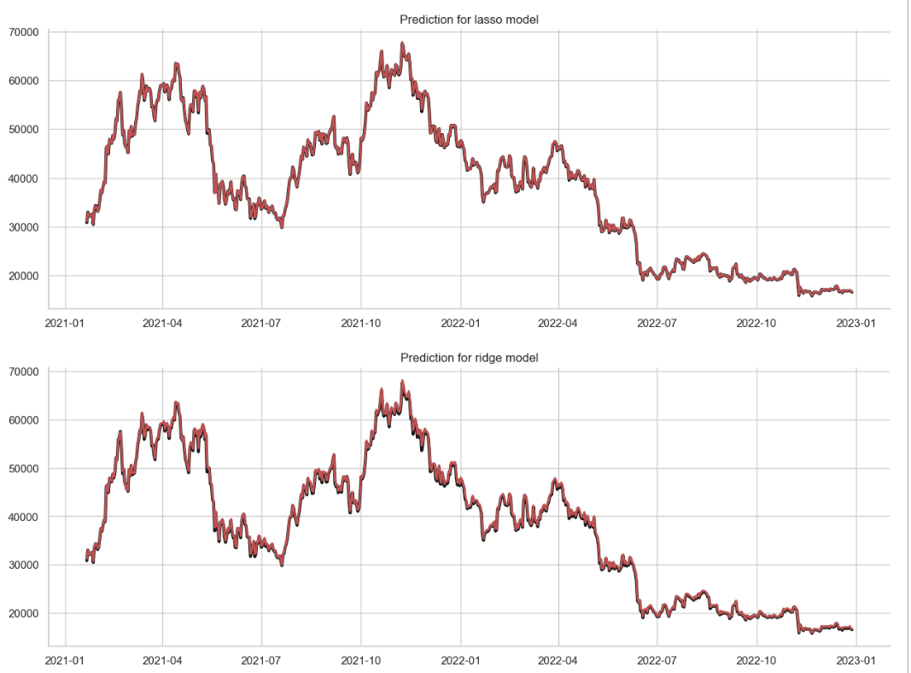
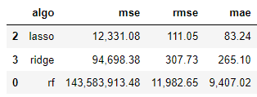
21
Introduction to companies and topics in the FINTECH industry
Cryptocurrency price prediction - Evaluation
Random Forest Regressor
Lasso Regression
Ridge Regression
Introduction to companies and topics in the FINTECH industry

Slide 22
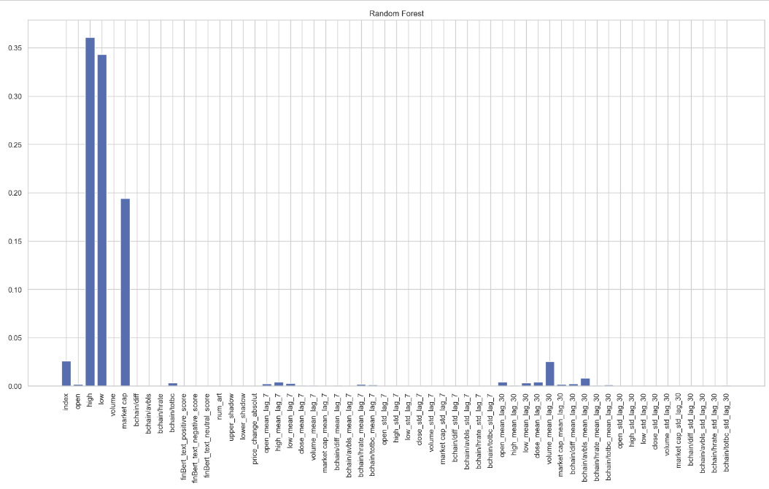
22
Introduction to companies and topics in the FINTECH industry
Cryptocurrency price prediction - Evaluation
Random Forest Regressor
Introduction to companies and topics in the FINTECH industry

Slide 23
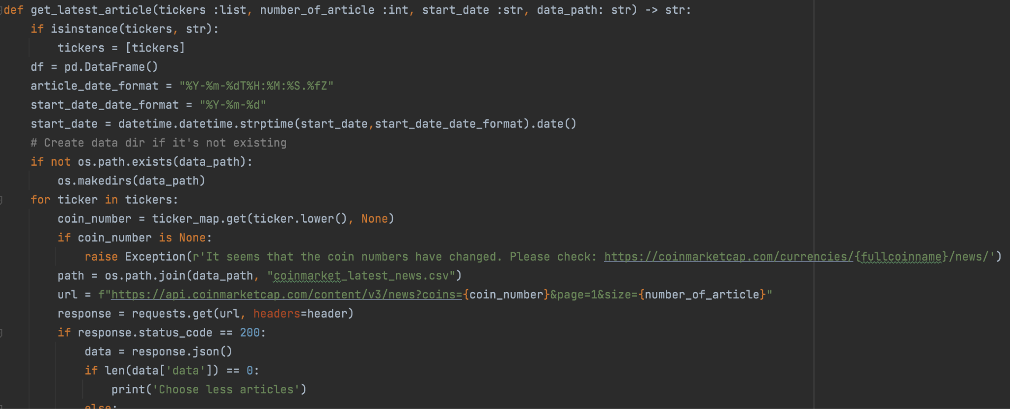
23
Introduction to companies and topics in the FINTECH industry
Cryptocurrency price prediction - Results
For the price prediction, the necessary functions to gather the data were developed, and by simply making a pipeline to extract the news and price data continuously, price prediction can be accomplished using the trained model.
Introduction to companies and topics in the FINTECH industry

Slide 24
24
Introduction to companies and topics in the FINTECH industry
Conclusion
Further improvements:
Implement pipeline for live forecasting
Compare mdels with data from different sentiment models
Combine different cryptocurrency data
More advanced methods - Neural Networks
Customize dictionary of sentiment models
Try different feature combinations
Introduction to companies and topics in the FINTECH industry

Slide 25

25
WAS IST MICROSOFT 365 &
SHAREPOINT?
WEITERES VORGEHEN
QUESTIONS?
Notes:
https://www.pexels.com/photo/white-mug-on-red-background-2916450/

